Slide 1
PROJECT TITLE
CAPSTONE PROJECT
Presented By:Vanaja Asmath
Student Name : Vanaja
College Name & Department : National Acadamy of CyberSecurity

Slide 2
OUTLINE
Problem Statement
Technology used
Wow factor
End users
Result
Conclusion
Git-hub Link
Future scope

Slide 3
Problem Statement
Steganography project: In this project i installed open stego and download set-up open stego-0.8.6-exe.I created a new folder .In this folder i download image,text document, and confidential information.In open stego inserted all files and create password, encrypt all files.After I installed python and pip install cv2 and then I go to command prompt and installed pip install opencv – python. I opned Idle and insert encryption and decryption code and go to Run tool and Run module and enter my secret message ,enter my password.Finnaly I successfully completed this project.

Slide 4
Technology used
I used cv2 library.In Python, cv2 is the convertional import alias for the OpenCV(Open Source Computer Vision Library).It is used for various computer vision tasks,including image and video processing,object detection, and analysis> The “cv” part of cv2 is derived from “Computer Vision,”and the “2” indicates that it is the second major version of the library.

Slide 5
Wow factors
What makes this project stand out from other project(Unique features)
This project is unique because this project encrypt the confendential data in image.It is very complex to reveal data to hackers.Thats why unique project than other projects.

Slide 6
End users
Who are the end users
End user are the people who use a product or service, and are also known as end consumers. They are the final users of a product, and they are the people that product development teams design products for.

Slide 7
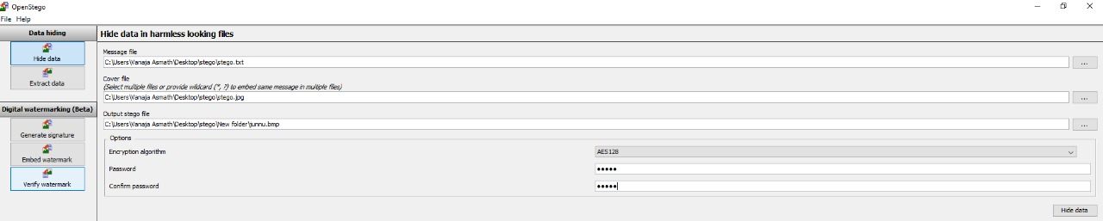
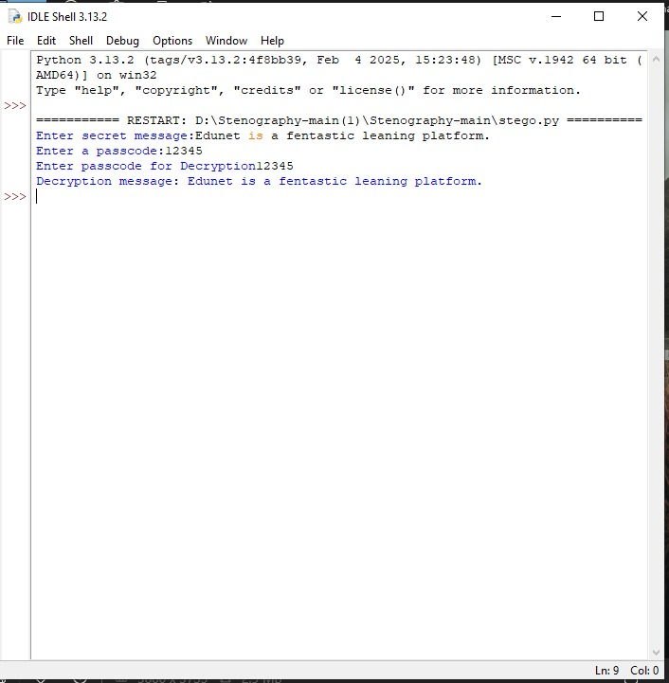
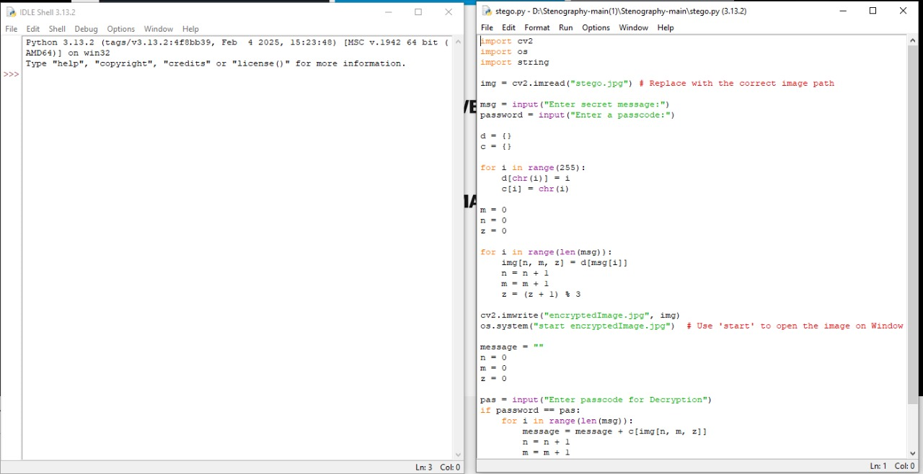
Results
Screenshots of the outcome (min 3)

Slide 8
Conclusion
Conclude your project concerning your problem statement:
It was wonderful and learning experience for me while working on this project.
This project took me through various aspects of project and taught me about research and findings.It also gave me real insight into this project topic.this project was full of thrill and joy. I learnt alot about this project and how to deal with challenges.
Thank you for giving me this project . I enjoyed every bit of doing it.

Slide 9
GitHub Link
Make sure that there should be readme file

Slide 10
Future scope(optional)

Slide 11
THANK YOU

